Slide 1
Financial Instruments
Accelerating zero-emission building sector ambition in the MENA region
Farid Comaty
Beirut, Lebanon
5 July 2018

Slide 2
Three questions to be addressed in my presentation
What needs did we identify in the scope of financing energy efficiency measures ?
What tool have we developed to address those needs ?
How is our tool being used in practice ?

Slide 3
Need number One Majority not conducting economic valuations
Do you conduct a cost benefit analysis
for choosing heating and cooling designs?
80%
20%
Economic Assessment
Static payback period
0%
Net Present Valuation
17 project developers interviewed
40%
30%
Static payback period
Economic Assessment
Net Present Valuation
(NEEREA obligation)
21 project developers interviewed
30%
50%
40%
Static payback period
Economic Assessment
Net Present Valuation
22 project developers interviewed
10%
Notes:
Why don’t you perform economic assessments calculations ?
We base our decisions on our experience in the field to advise our clients
The running costs of the system are incurred by our client so they are not relevant for us
Why do you conduct a payback calculation only ?
Easiest for the client to understand and easy to do
Why do you conduct an Net Present Valuation calculation ?
Because it’s the required by the NEEREA loan application
Because it’s the right method to evaluate the total cost of ownership for my client

Slide 4
Need number two alter the mindset of payback calculations
Advantage
Simple and easy method use to compare options
Simple language to talk with client
Disadvantage
Does NOT indicate the profitability of the asset over its lifespan
Does NOT allow benchmarking of options with re-investments
Does NOT take into account the time value of money
Does NOT allow project developer to communicate with financial institutions
Solution
Need a tool that can illustrate the value of NPV vs Payback for our customers
Need a tool that can help me benchmark different energy efficiency options

Slide 5
Need number three Improve the calculation of net present valuation
The calculation approach is not uniform across applications
Some consider free risk loans over the whole life
Some consider discount rates but do not share the rate
Some consider the grace period as totally free (no interest rate)
Some do not consider inflation and energy price fluctuations
Some do not consider depreciation over the lifetime neither considers
Methodology of calculation is not accurate
The difference in capital cost with the baseline is not taken into account which influence the NPV of the measure
When assessing heat pumps, only heating options were compared to baseline, whereas it’s the benefits of heating + cooling that should be considered
Inputs are not fixed and outputs are not standardized
Setting a technology baseline to compare each energy efficiency measure

Slide 6
Need number four understand the impact of input variables
Questions raised by project developers during training sessions:
“How will an increase or decrease in energy prices affect the net present valuation of my heat pump?”
“How will the grace period or the interest loan affect the payments I need to do the bank?”
“How does the grace period or the interest loan affect the net present value of energy efficient options?”
“What is the maximum allowable risk I can take in this project so that it is still financially attractive?”

Slide 7
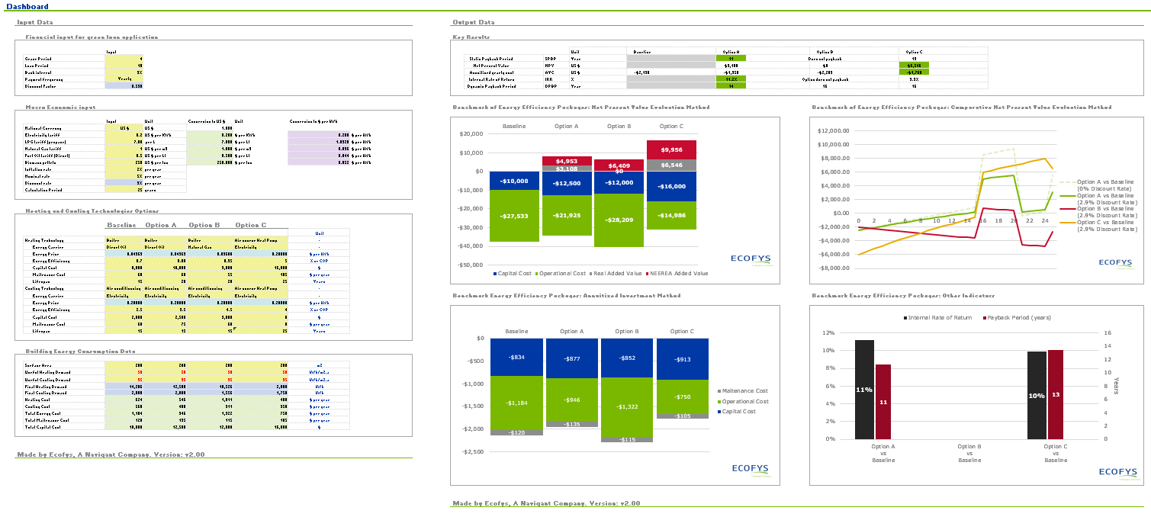
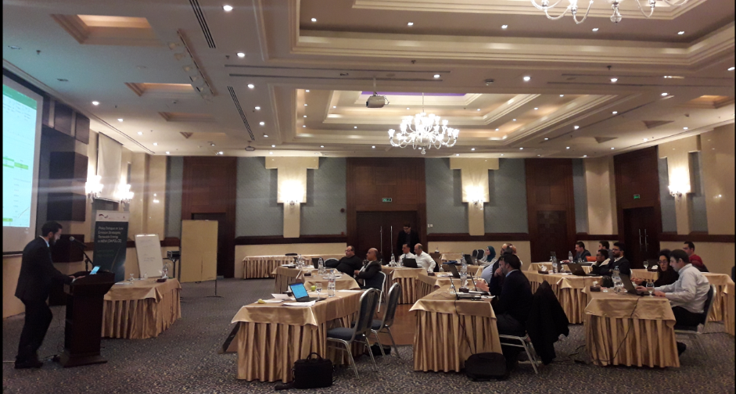
What did we do? Capacity-Building for economic assessments
Ecofys developed a dynamic standardized excel-based tool to evaluate the cost effectiveness of heating and cooling technologies
The tool is designed to take financial and macro economic inputs tailored to each country
Trainings were organized with project developers in parallel to the national workshops
Feedback from participants was used to enhance and tweak the tool

Slide 8
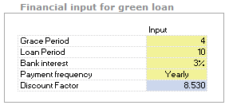
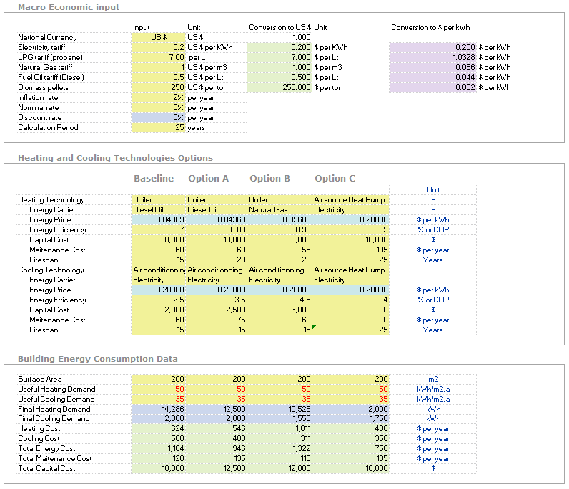
Structured Inputs Financial, macro-economic & Engineering Input
Finance data
Economy data
Equipment data
Engineering data

Slide 9
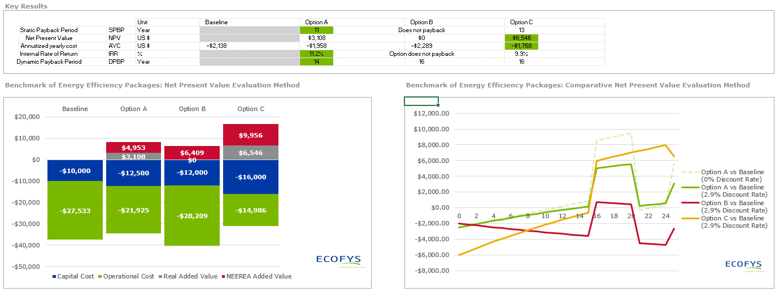
Visual Outputs Financial indicators and benchmarking of options
With respect to the financial and macro-economic inputs given today:
Engineer would choose Option A following a static/dynamic payback period
Over a calculation period of 25 years, its Option C with a lifespan of 25 years that has highest NPV
The tool illustrate re-investment cycles and compare Options on a fair basis (i.e heatpumps vs cooling+heating of baseline)
The tool illustrate the added value of the NEEREA loan, for shifting the down payment of the capital cost over the loan period

Slide 10
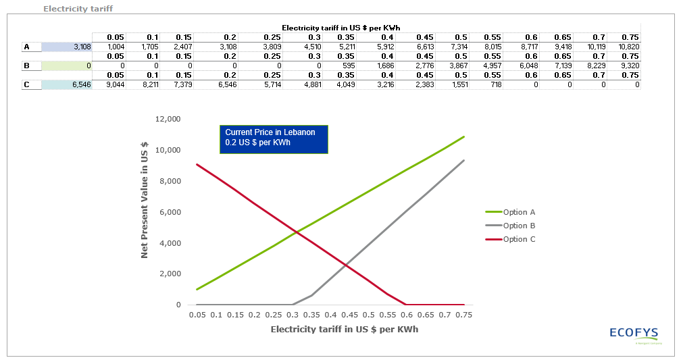
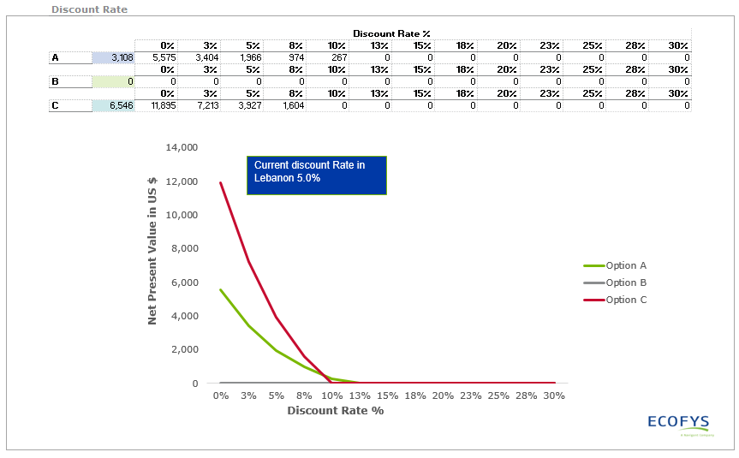
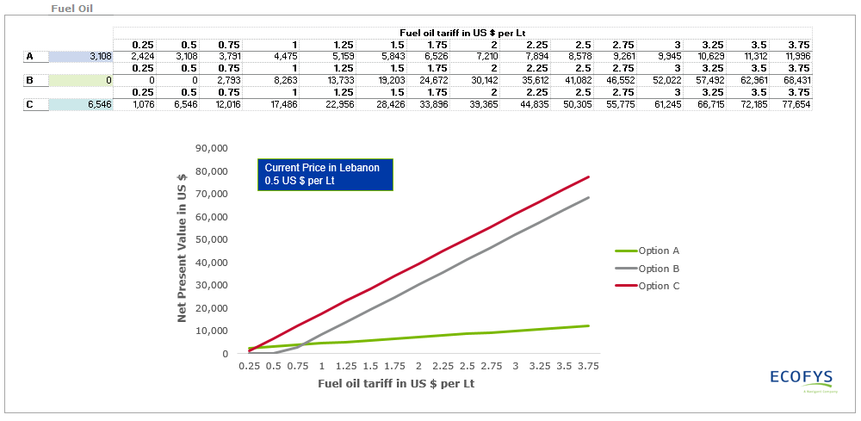
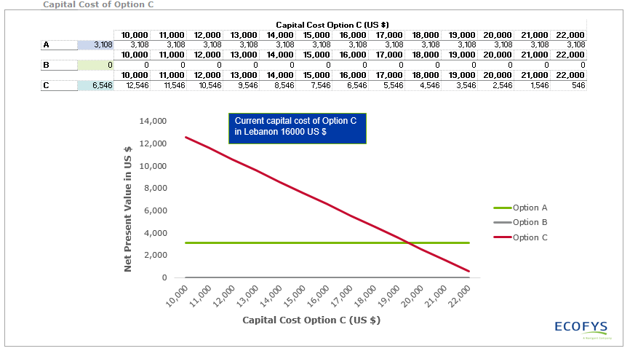
Sensitivity analysis fuel prices, discount rates and capital cost

Slide 11
How has the tool been used? Real case studies in Lebanon
The Project
Heating/Cooling solution for Dar El Sadaka orphanage, Zahle (11 buildings).
Options:
Diesel Boilers, Air Conditioners & PV System (Baseline)
Air Conditioners & PV System (Option A)
High-Efficiency Heat Pump & PV System (Option B), low-interest rate applies
Tool Used For:
Feasibility study for 3 options
Evaluation considered initial investment, operation and maintenance costs, time-value of money, and interest rate
Results:
Option B is most feasible considering 20-year calculation period.

Slide 12
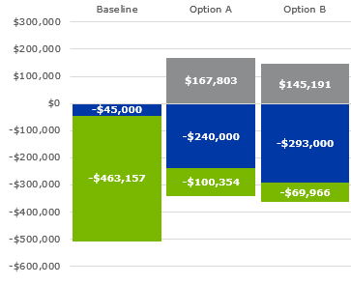
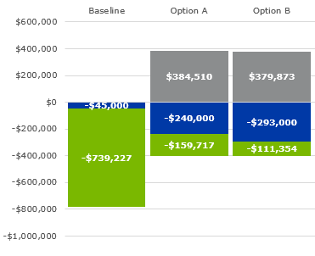
How has the tool been used? Real case studies in Lebanon
Chart to left shows results with normal interest rate, while chart to left includes low-interest rate.
Low rate only applies to Option B, which is why it turned out to be most fesible.

Slide 13
How Will the tool been used? Likely roll out of the tool for NEEREA (In process)
Inform
central banks
Train project developers
Train commercial banks

Slide 14
Thank you for your attention Questions?

Slide 15
Farid comaty Senior Consultant, Energy Systems +49 (0) 30 297 73579-69 farid.comaty@navigant.com

